Slide 1
The magnificent puzzles of Raymond Smullyan

Slide 2
Raymond Smullyan
Lived: 1919-2017
Student of Alonzo Church
Professor of philosophy and mathematical logic

Slide 5
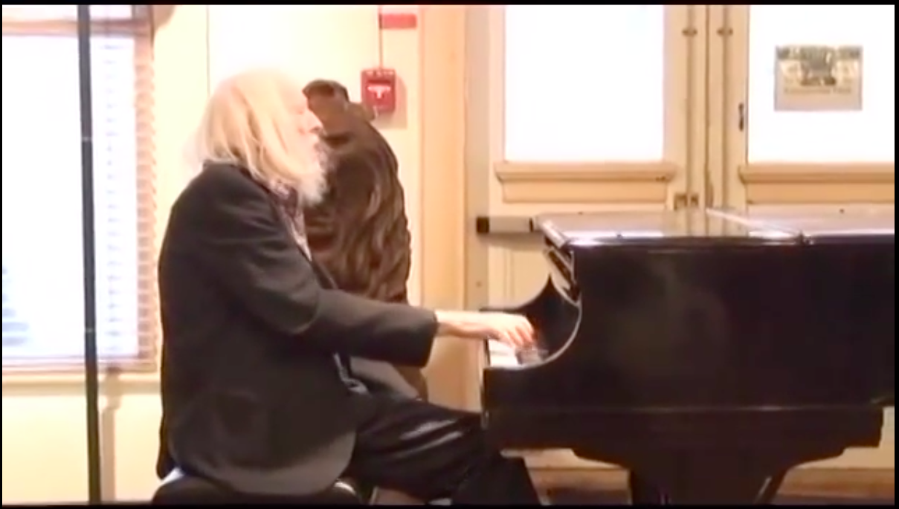

Slide 7
What was Smullyan up to?
"Among the numerous fascinating letters I have received .. one was from the ten-year-old son of a famous mathematician who was a former classmate of mine. The letter contained a beautiful original puzzle, inspired by some of the puzzles in the book which the boy had been avidly reading. I promptly phoned the father to congratulate him on his son’s cleverness. Before he called the boy to the phone, the father said to me in soft conspiratorial tones: “He is reading your book and loves it! But when you speak to him, don’t let him know that what he is doing is math, because he hates math! If he had any idea that this is really math, he would stop reading the book immediately!

Slide 8
Goals for today
Enjoy solving mathematical puzzles
Learn about logic in the process

Slide 9
Barber Puzzles

Slide 10
A puzzle about barbers
My friend told me that in a certain Hungarian village, there lives a barber who shaves all and only residents who do not shave themselves.
I told my friend she must be mistaken. How did I know?

Slide 11
Now you try it
Instructions: Working in groups, alone, or any way you like, try the section Puzzling Barbers on your worksheet.

Slide 12
What’s going on here?
Set theory: Mathematical study of sets (= collections of things).
Some sets: {0,1,2,3,…} (natural numbers); {donkeys}
New sets from old: {0,1,2,3,…} U {donkeys} = {things that are natural numbers or donkeys}

Slide 13
Russell’s Paradox
Naïve comprehension axiom: If P is a property, then there is a set of all/only the objects with property P
This leads to paradox!

Slide 14
The paradox explained
Let P be the property “is not a member of itself”
Let S be the set of all sets with property P
If S is a member of itself: then S is not a member of itself
If S is not a member of itself: then S is a member of itself
Let P be the property “does not shave itself”
Let S be a barber who shaves all/only those who do not shave themselves
If S shaves himself: then S doesn’t shave himself
If S doesn’t shave himself: then S shaves himself

Slide 17
The lady or the tiger? Day One

Slide 18
Now you try it!
Try the section The Lady or the Tiger: Day One on your worksheet

Slide 19
Some helpful symbols
L₁: There is a lady in Room 1
L₂: There is a lady in Room 2
Not-L_{i}: There is not a lady in room i

Slide 20
The second trial

Slide 21
The lady or the tiger? Day Two

Slide 22
Now you try it!
Try the section The Lady or the Tiger: Day Two on your worksheet using any methods you’d like

Slide 23
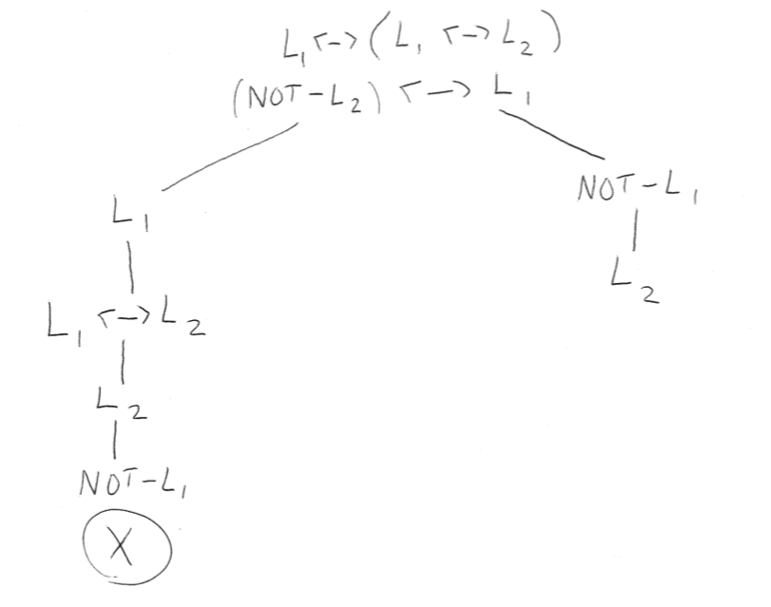
The sixth trial

Slide 24
The Island of Knights and Knaves

Slide 25
Now you try it
Try the section The Island of Knights and Knaves on your worksheet
If you’d like to use tableau methods, I’d suggest “T(X)” for “X is a knight”. Exploit analogies to truthful and lying signs from Day 2.
Warning: Sometimes tableau methods will be very hard!

Slide 26
Some helpful symbols
T_{C}: C is a knight
T_{G}: G is a knight

Slide 27
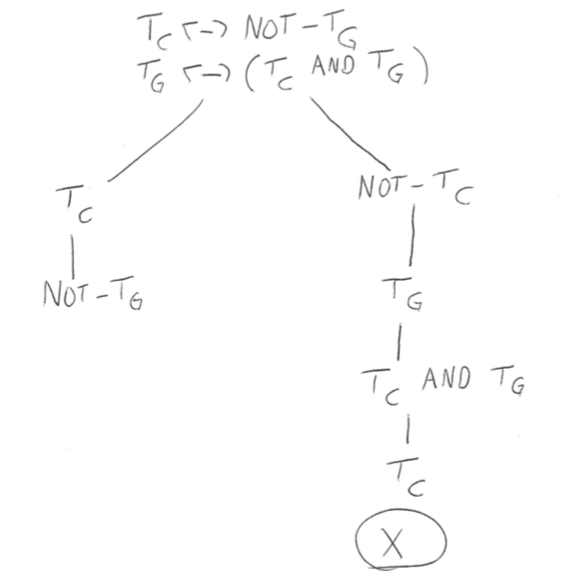
Cary and Grant

Slide 28
The search for Arthur York

Slide 29
Now you try it
Using any method you’d like, try the section The Search for Arthur York

Slide 30
Some helpful symbols
Claim operators: C_{H}(“blah”): “H claims [tenselessly] that blah”
Identity: A = B: “A and B are identical”

Slide 31
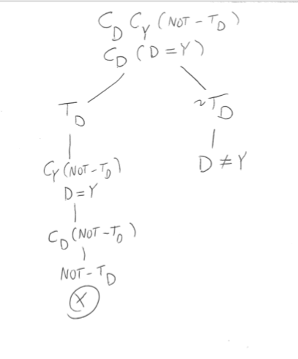
The first trial

Slide 32
Some facts about Knights and Knaves

Slide 33
Now you try it
Try the section Some Facts about Knights and Knaves

Slide 34
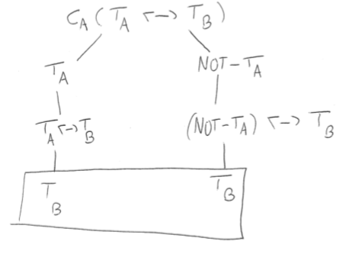
Fact Five

